Slide 1




AIRLINE PROJECT
From Raw Data to Actionable Insights

Slide 2


Introduction
Data Sources and Tools
Data Processing and Cleaning
Dashboard Design and Insights
Q&A
TABLE OF CONTENT

Slide 3

NAVIGATING THE SKIES: TRANSFORMING DATA INTO ACTIONABLE INSIGHTS
Imagine a world where every flight takes off on time, every airport operates at peak efficiency, and every passenger enjoys a seamless travel experience. While this might sound like a dream, it’s a goal we can achieve by harnessing the power of data.

Slide 4
PROBLEM STATEMENT:
"Airports and airlines face countless challenges—delays, inefficiencies, and operational bottlenecks. These issues not only frustrate passengers but also cost the industry billions of dollars annually. But what if we could turn this chaos into clarity?"

Slide 5

"That’s exactly what we’ve done. In this project, we’ve analyzed airport operations, aircraft performance, flight schedules, and delays to uncover hidden patterns and insights. Our goal? To empower decision-makers with the tools they need to optimize performance, reduce delays, and enhance the passenger experience."
PROJECT PURPOSE

Slide 6

"So, fasten your seatbelts and get ready to take off on a journey through data. By the end of this presentation, you’ll see how we’re turning raw data into actionable insights—one flight at a time."

Slide 7

"Using Power Query for data cleaning and transformation, we’ve created a collection of interactive dashboards that provide real-time visibility into key metrics. From tracking on-time performance to identifying delay hotspots, these dashboards are designed to drive smarter, data-driven decisions."
WHAT WE’VE BUILT

Slide 8
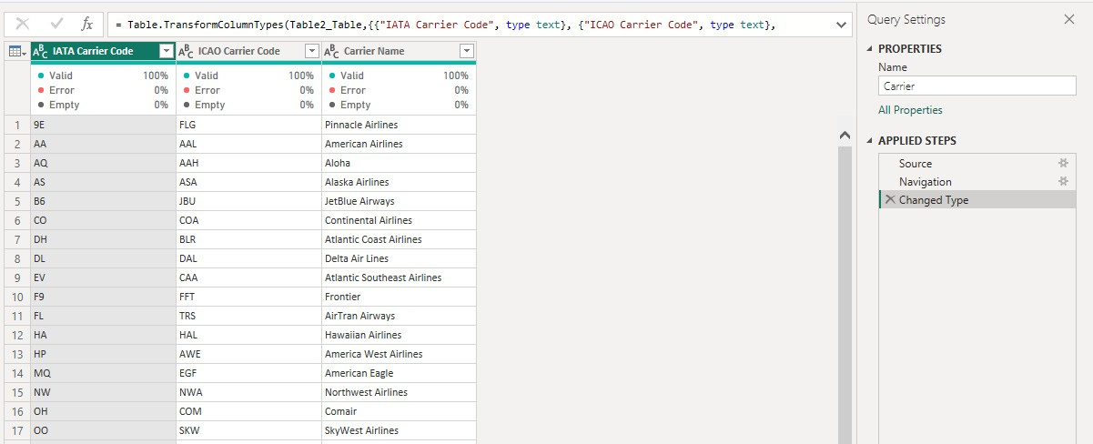
Carrier Table
01

Slide 9
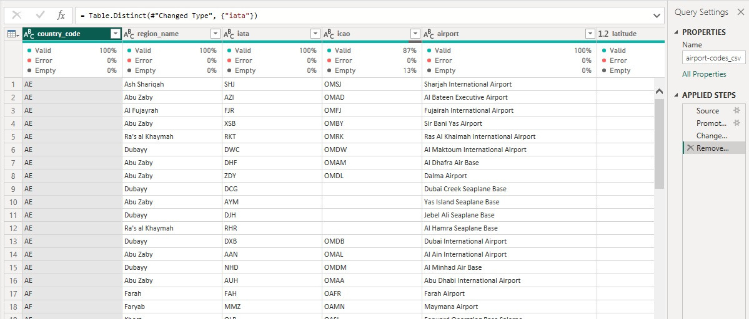
Airport Table
02

Slide 10
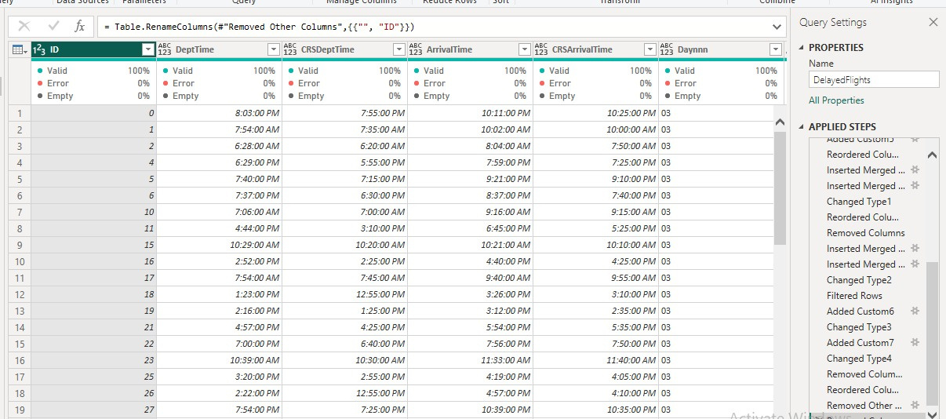
Delayed FlightsTable
03

Slide 11
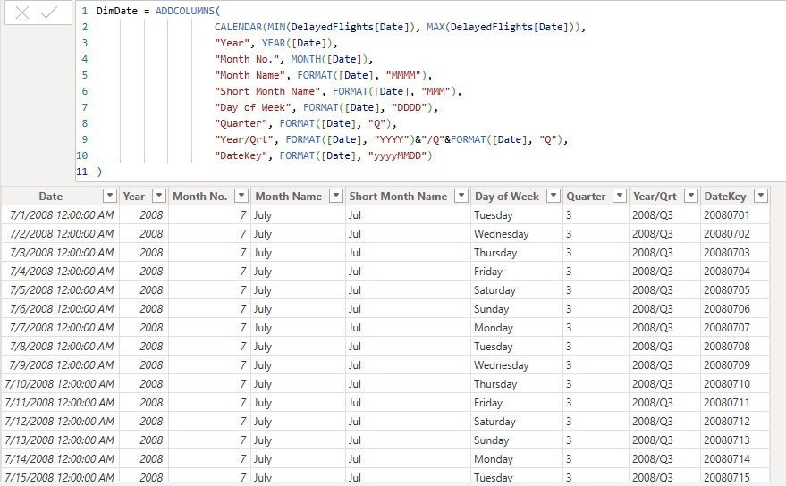
DimDate(DAX)
04

Slide 12
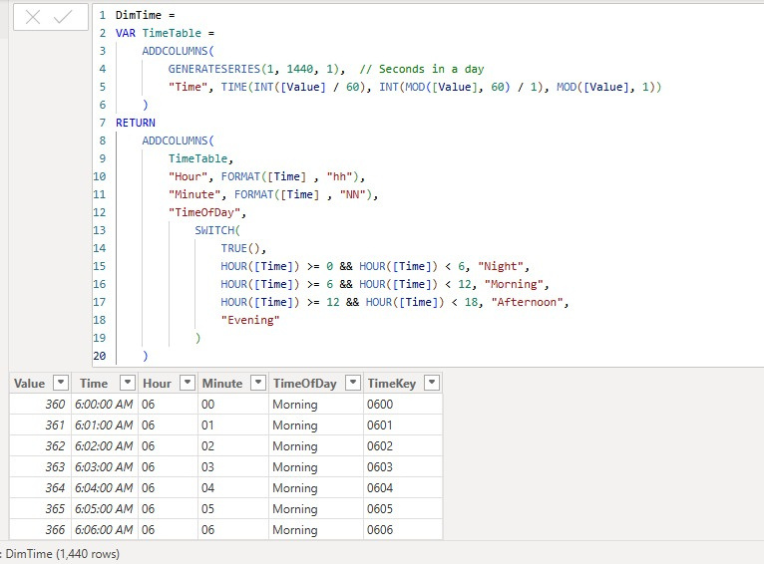
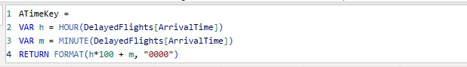
DimTime(DAX)
05

Slide 13
ATimeKey(DAX)
06
For arrivalTimeKey

Slide 14
deptTimeKey(DAX)
07

Slide 15
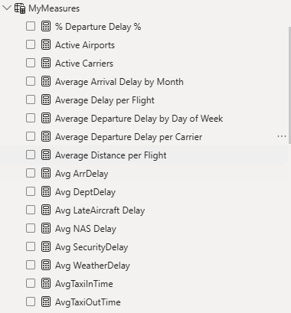
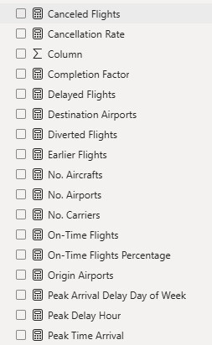
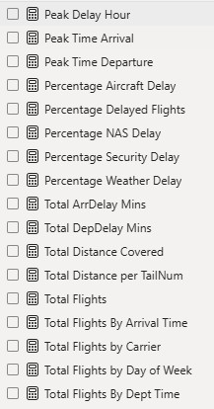
All DAX Measures
08

Slide 16
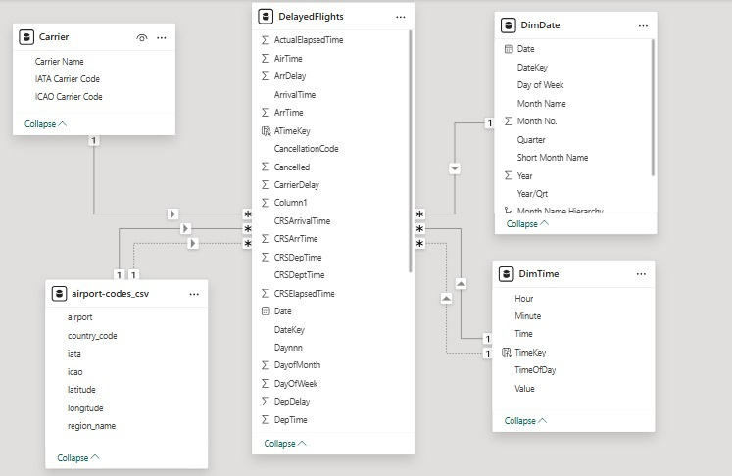
Data Schema Model
09

Slide 17



PROJECT DASHBOARDS
Airports
Homepage
OverviewPage
Delay
Flights

Slide 18
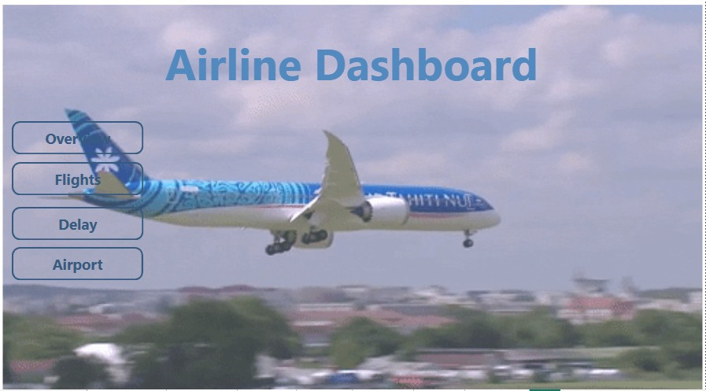
Homepage
01

Slide 19
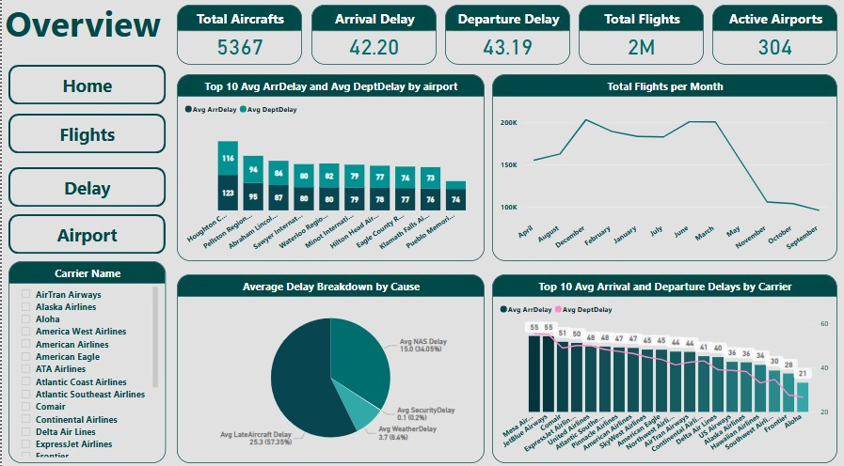
Overview Page
02

Slide 20
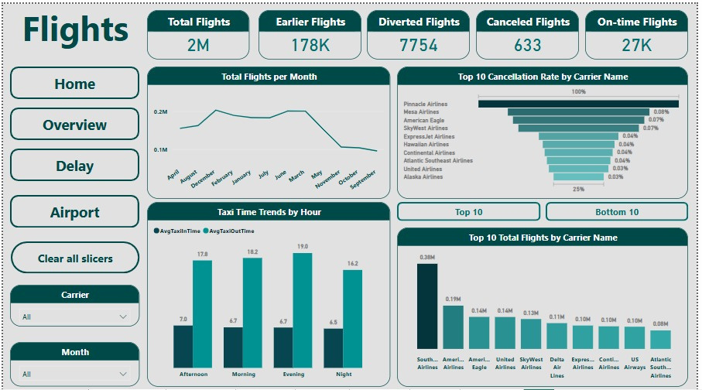
Flights Page
03

Slide 21
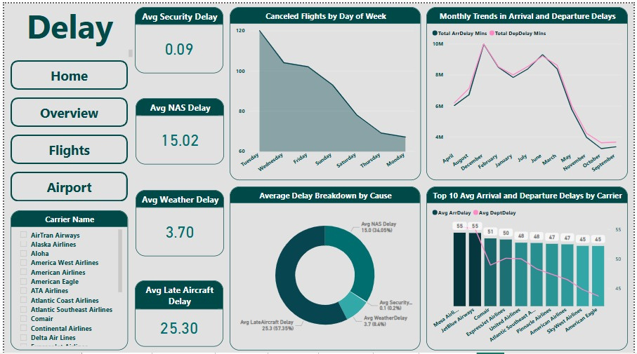
Delay Page
04

Slide 22
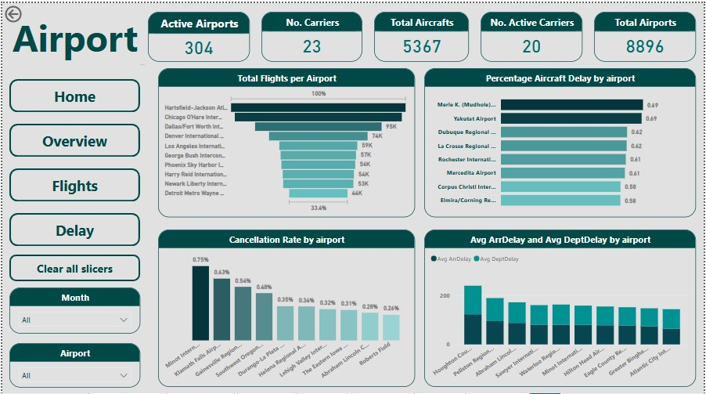
Airport Page
05

Slide 23
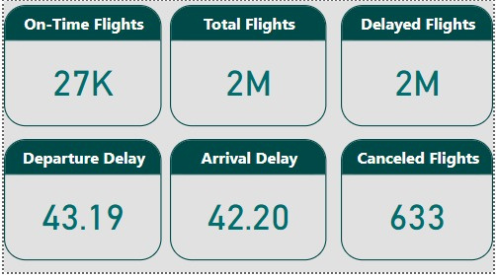
TOOLTIP

Slide 24
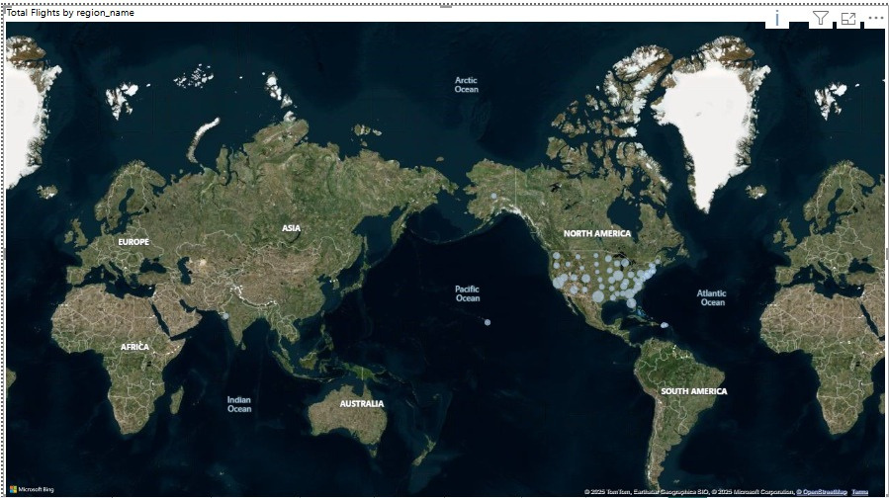
MAP
(FORVISUALIZING TOOLTIP)

Slide 25
CLEARED FOR TAKEOFF: TRANSFORMING DATA INTO ACTION
By turning complex data into actionable insights, we’re not just solving today’s problems—we’re paving the way for a more efficient and reliable aviation industry.
We invite you to explore these dashboards further and collaborate with us to refine and expand their capabilities. Together, we can ensure smoother operations, happier passengers, and a brighter future for air travel.

Slide 26

THANK YOU FOR JOINING US ON THIS JOURNEY THROUGH DATA.

